Slide 1
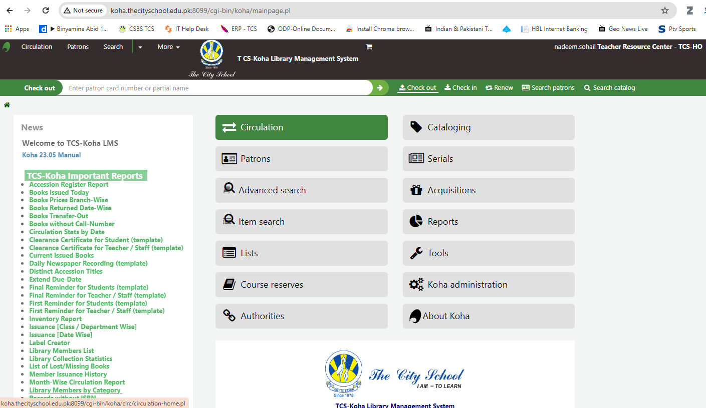
TCS-Koha: Library Management System
By: Nadeem Sohail

Slide 2
TCS-Koha Training Outline
Introduction of TCS-Koha
Koha Interfaces
Cataloging of Books in Koha
1
How to Classify Books
Copy cataloguing
2
How to add multiple book copies?
How to edit of book record?
How to print barcodes?
3
How to check-out and check-in the books?
How to print overdue reminders?
Lost and Paid Management
4
Report Module
Recap of Training
Question answers sessions
5

Slide 3
Koha Introduction…1
Welcome to the TCS-Koha 23.05, an open-source Integrated Library System (ILS) designed to empower TCS libraries
First free and open-source integrated library management system (ILMS)
Provides comprehensive functionality for managing library operations
Created in 1999 by Katipo Communications for the Horowhenua Library Trust in New Zealand, and the first installation went live in January 2000.
Development of Koha is sponsored by various libraries, volunteers, and support companies around the world.
TCS-Koha Customized by Nadeem Sohail in with collaboration TCS-IT and Muhammad Zaheer RCL-CR

Slide 4
TCS-Koha Introduction…2
Koha is a powerful ILS that stands out for its flexibility, scalability, and cost-effectiveness.
Developed by a global community of volunteers, maintained by the Koha Community
Adopted and configured by the TCS Libraries department head office in Lahore led by Nadeem Sohail Manager Libraries head office Lahore
Koha open-source solution offers a range of features to streamline library operations, enhance user experiences, and adapt to evolving library needs.

Slide 5
Features of TCS-Koha…1
Web 2.0 and Web 3.0 futures
Customizable
Union catalogue (all schools can have the same interface)
Manage Large Groups and networks like TCS
Customizable User Interface/OPAC
Online & Off-Line Circulation
Copying Cataloging
Self-check-in check-out

Slide 6
Features of TCS-Koha…2
Bar code and Labels printing
Patron card creation
Auto email alerts
Flexible Report Generation
Online Documentation & Support
Worldwide database experts
Users self-registration
International training and workshops available
Used in local libraries and large networks
Continuously Updated by an open-source community (23.11 versions)

Slide 7

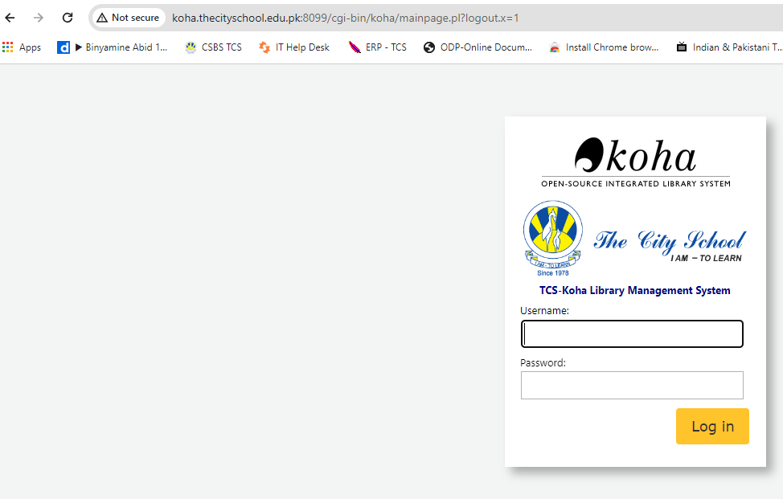
How to Login?
Open Internet Brewers
Inter URL
Koha logging
Koha password

Slide 8

To Reset Your Password:
Always keep your login credentials confidential to maintain the security of the system.
If you forget your password, to reset it contact your RCLs

Slide 9
TCS-Koha 23.5 Main Interface Overview
Two Main Interfaces of Koha
Staff/Librarian Interface: http://koha.thecityschool.edu.pk:8099/
Student and Teacher interface: http://koha.thecityschool.edu.pk:8081/

Slide 10
http://koha.thecityschool.edu.pk:8081
http://koha.thecityschool.edu.pk:8099

Slide 11
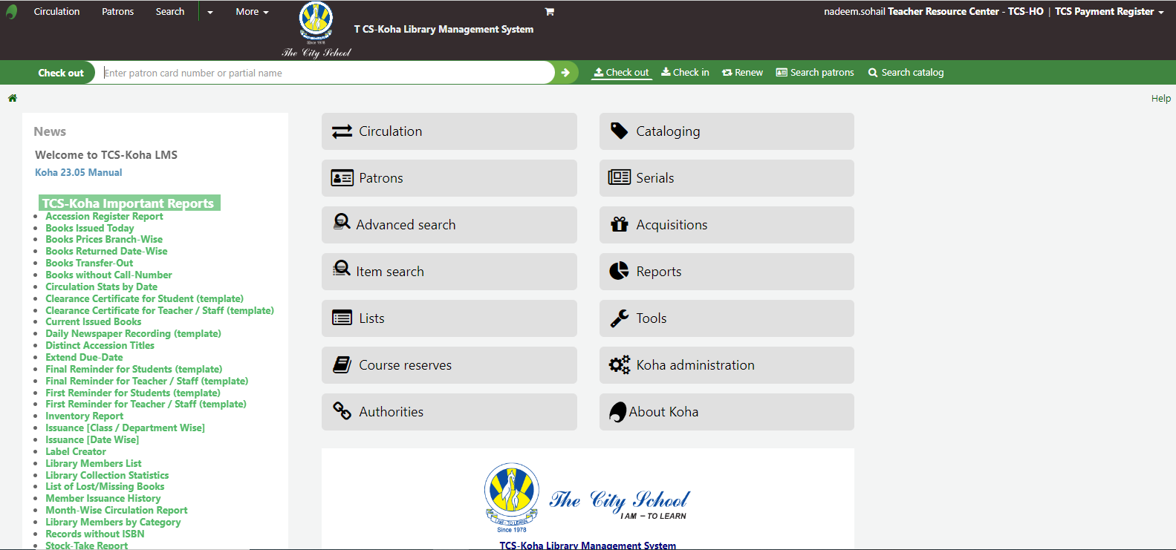
Staff/Librarian Interface

Slide 12
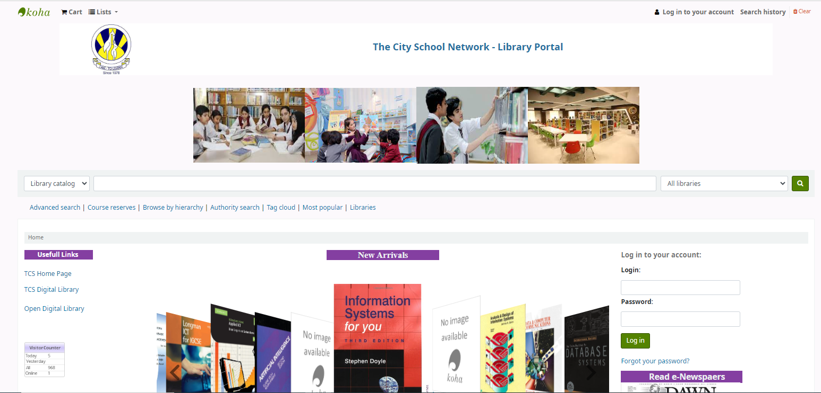
OPAC Online Public Access Catalogue: User interface

Slide 13
Accessibility and Mobile Responsiveness:
Koha prioritizes accessibility and user-friendliness.
The OPAC interface is designed to be responsive, ensuring a seamless experience across various devices, including desktops, tablets, and smartphones.
Whether you are a casual reader, a student, or a research enthusiast, the TCS-Koha OPAC is your gateway to the vast resources housed in your library.

Slide 14
Cataloging of Books in Koha

Slide 15
MARC: Machine-Readable Cataloging
MARC, which stands for Machine-Readable Cataloging, is a standard for the representation and communication of bibliographic and related information in a machine-readable format.
Developed by the Library of Congress, MARC records enable libraries to efficiently manage and exchange bibliographic data across different systems and platforms.

Slide 16
Key Components of MARC:
1-Leader:
The leader provides essential information about the record, such as its type, bibliographic level, and encoding information.
Directory:
The directory contains a list of tags indicating the location and length of each data element within the record.
3- Control Fields:
These fields contain data elements that provide overall information about the bibliographic record, such as the title, author, publication date, and more.
Variable Fields:
These fields accommodate various data elements related to the bibliographic information, such as subject headings, notes, and additional author information.

Slide 17
Advantages of MARC
Interoperability:
MARC facilitates the exchange of bibliographic data between different library systems, promoting interoperability and resource sharing.
Standardization:
The use of a standardized format ensures consistency in cataloguing practices across libraries, making it easier to share and merge cataloguing information.
Efficiency:
MARC records enable automated processes for cataloguing, searching, and retrieval, saving time and effort for librarians.

Slide 18
Most Common MARC Tags:
Leader (LDR):
Provides information about the record as a whole, such as its type, bibliographic level, and character encoding.
Control Number (001):
Unique identifier assigned to the record.
Control Fields:
005: Date and Time of Latest Transaction
008: Fixed-Length Data Elements

Slide 19
MARC Variable Fields:
020: ISBN (International Standard Book Number)
100: Main Entry—Personal Name (Author)
245: Title Statement (Title and Subtitle)
260: Publication, Distribution, etc. (Place, Publisher, Date)
300: Physical Description (Extent of the Item)
500: General Note
650: Subject Added Entry—Topical Term
700: Added Entry—Personal Name (Additional Authors)
856: Electronic Location and Access (URL for Online Resources)

Slide 20
MARC Subfields
$a: Main term or title.
$b: Edition.
$c: Place of publication.
$d: Date of publication.

Slide 21
What is AACR-II?
AACR-II, or Anglo-American Cataloging Rules, Second Edition, is a comprehensive set of cataloguing rules
Developed to standardize the creation of bibliographic records.
These rules provide guidelines for describing library materials
Ensuring consistency and facilitating access to information.

Slide 22
Eight Access Points for Books:
1. Main Entry:
2. Title and Statement of Responsibility Area
Edition Area:
Imprint Area:
Physical Description Area:
Series Area:
Notes Area:
8. Standard Number and Terms of Availability Area:

Slide 23
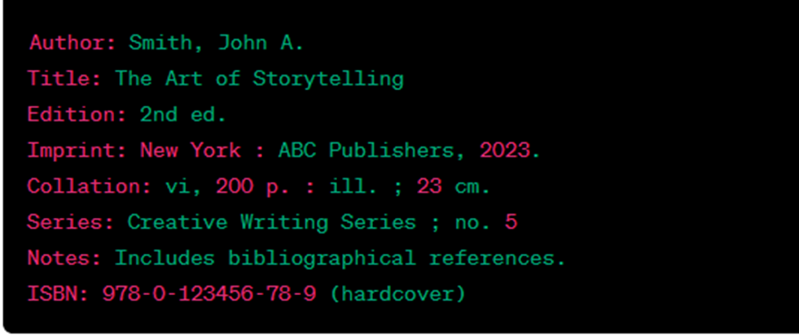
Sample AACR-II Catalog Card for a Book

Slide 24
What is RDA?
Resource Description and Access (RDA) is a set of guidelines and instructions for creating bibliographic records.
RDA represents a shift from the traditional cataloguing rules
Providing a more flexible and user-focused approach to describing and accessing resources
RDA is designed to adapt to the evolving landscape of information resources in the digital age

Slide 25
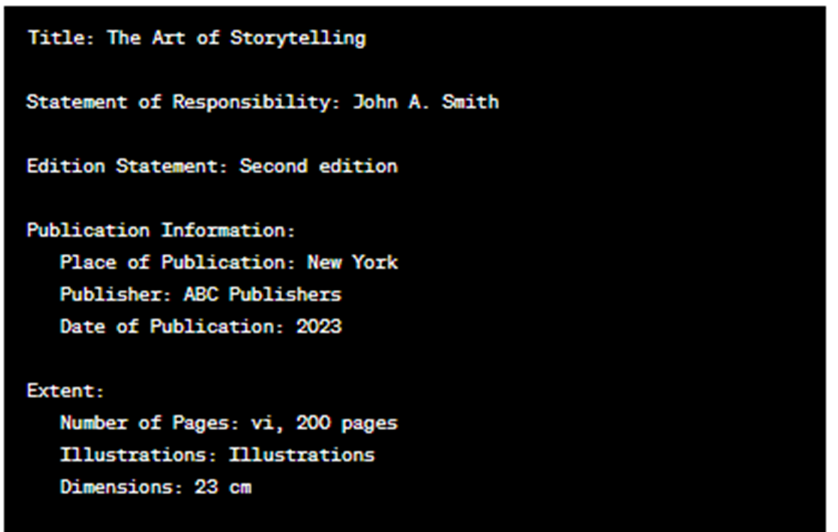
Cataloging Card with Major Elements of RDA

Slide 26
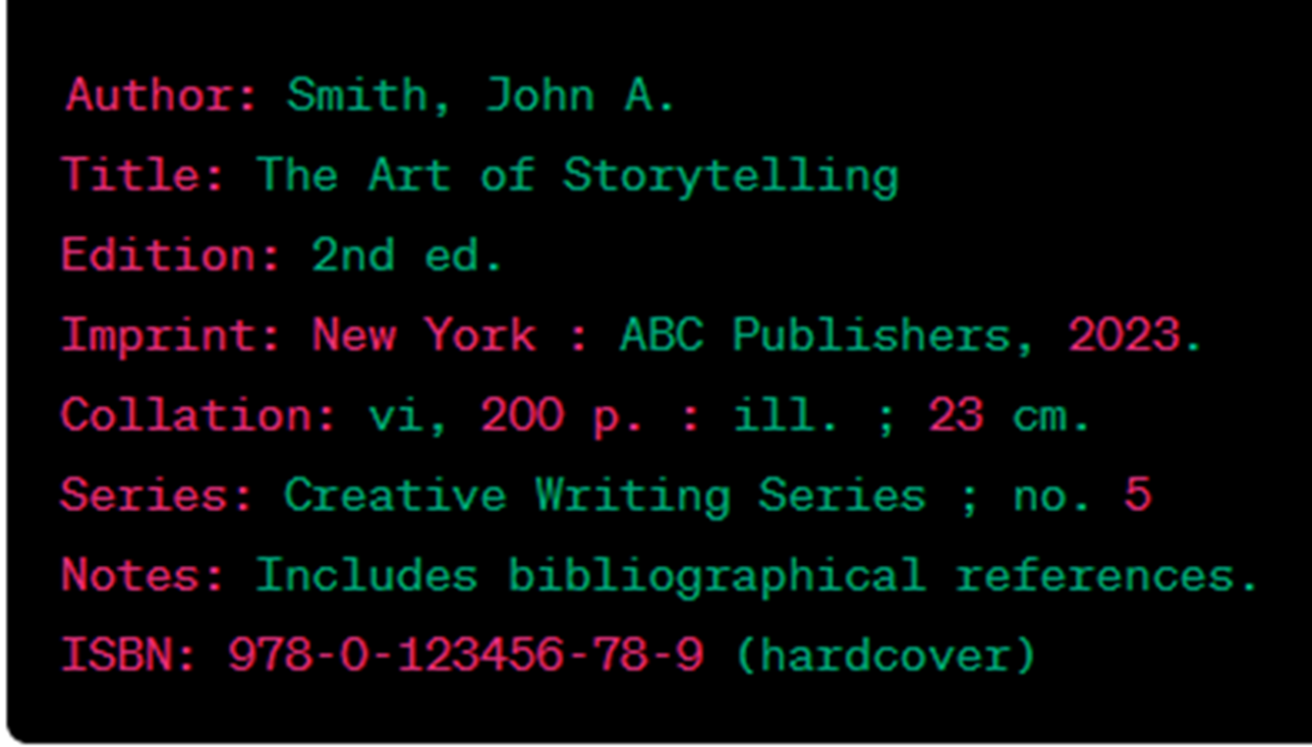
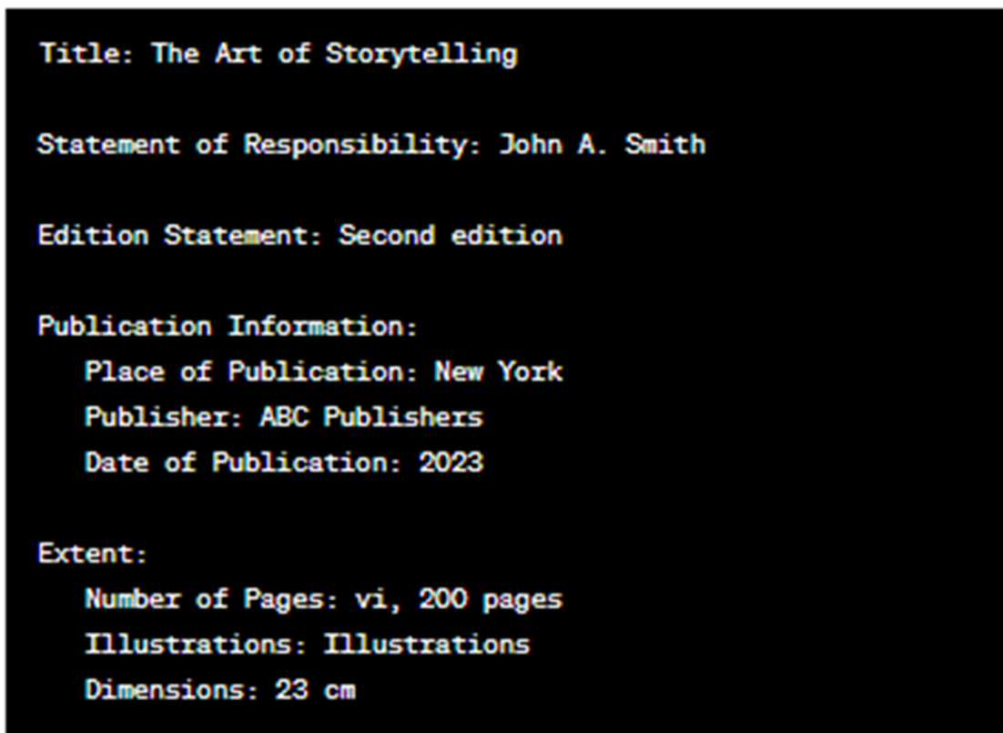
AACR-II vs. RDA
AACR-II VS RDA.

Slide 27

THANK YOU!

